Slide 1

Microservices
Calin-Ioan Nicoara Senior Software Developer and Trainer

Slide 2

Let’s get to know each other
Notes:
De ce?
Experienta
Asteptari

Slide 3
Outline
Microservice architecture
Intercommunication
Security
Testing strategies
Deployment
Monitoring

Slide 4
What are Microservices?
A microservice application is a collection of independent services, each doing one thing well, that work together to perform more complex operations.
Notes:
Each microservice is responsible for a single capability. This might be business related or represent a shared technical capability, such as integration with a third party (for example, the stock exchange).
A microservice owns its data store, if it has one. This reduces coupling between services because other services can only access data they don’t own through the interface that a service provides.
Microservices themselves, not the messaging mechanism that connects them nor another piece of software, are responsible for choreography and collaboration — the sequencing of messages and actions to perform some useful activity.
Each microservice can be deployed independently. Without this, a microservice application would still be monolithic at the point of deployment.
A microservice is replaceable. Having a single capability places natural bounds on size; likewise, it makes the individual responsibility, or role, of a service easy to comprehend.

Slide 5



Before Microservices
Monolithic Tight coupling
Traditional SOA Looser coupling
Microservice Decoupled
All elements must agree on each change
Elements must be coordinated each other
Elements can be changed or added without prior coordination with others
Notes:
SOA - Service-Oriented Architecture
Deci, ar trebui să vă gândiți la Microservice ca o abordare specifică pentru SOA în același mod în care XP sau Scrum sunt abordări specifice pentru Agile
MS = autonom

Slide 6
Short history of microservices
AWS EC2
2006
Java EE6
2009
DropWizard
May 2011
Hystrix
March 2012
Eureka
July 2012
Spring Boot
Sept 2013
Kubernetes
June 2014
Continuous
Integration
via XP
1999
DevOps
2009
Agile
Manifesto
Feb
2001
NETFLIX
to AWS
2010
Ribbon
March 2012
Microservices
Assess
Thoughtworks
Radar
March 2012
Docker
March
2013
Microservices
Defined
Thoughtworks
Fowler, Lewis
March 2014
Notes:
RIBBON - Load balancer
Hystrix - Circuit Breaker
Eureka - Service Discovery

Slide 7
Microservices
the main characteristics

Slide 8
Scalability & High-availability
Notes:
Microservice applications have some interesting technical properties:
Building services along the lines of single capabilities places natural bounds on size and responsibility.
Autonomy allows you to develop, deploy, and scale services independently.

Slide 9



Organized around business capabilities
UI
Shipping
Server
Catalog
DBA
Orders
Notes:
- 2 pizza team
- You build it, you run it
SOA est pe orizontala (ui, business, datA)
Microservici sunt pe verticala

Slide 10
Autonomous (from design to deployment)

Slide 11

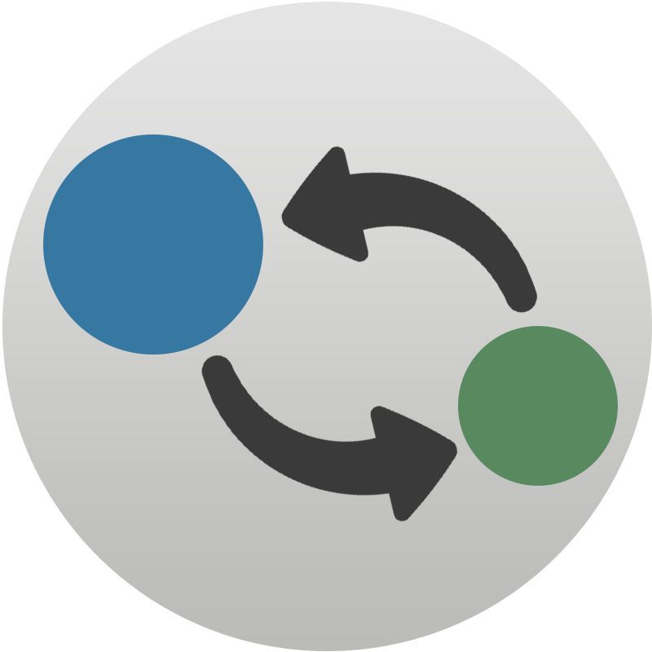
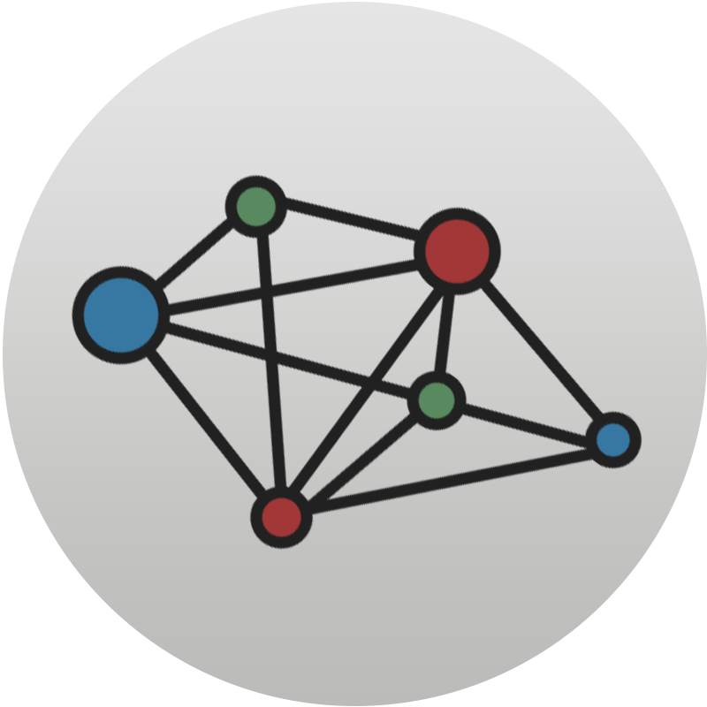


Microservice benefits
Autonomy
Speed of change
Scale
Tech Diversity
Intelligible
Autonomous team with isolated implementation
Build and deploy small independent services
Functional and Team Scaling
Allows try-out of new technologies
Lower cognitive load
Notes:
Reduce friction and risk
Isolating and minimizing dependencies at build time
Allowing developers to reason about cohesive individual components, rather than an entire system
Enabling the continuous delivery of small, independent changes

Slide 12
Disadvantages
of distributed computing
Latency
Partial failure
Infrastructure
Notes:
Partial failure - este si avantaj ex: nu merge facturarea
Muti complexitatea in infrastructura
Scoping and identifying microservices requires substantial domain knowledge.
The right boundaries and contracts between services are difficult to identify and, once you’ve established them, can be time-consuming to change.
Microservices are distributed systems and therefore require different assumptions to be made about state, consistency, and network reliability.
By distributing system components across networks, and increasing technical heterogeneity, microservices introduce new modes of failure.
It’s more challenging to understand and verify what should happen in normal operation.

Slide 13
Designing Microservices
Size Single Responsibility Principle
Scope Agile / Independent development and deployment
Capabilities Bounded Context in Domain-Driven-Design
Notes:
BoundedContext

Slide 14
Domain Driven Design
Tactical Design
Service
Project
Strategic Design
Layers
Modules
Domain
Modules
Sub-Domain
Sub-Domain
Sub-Domain
Design Patterns
Service
Service
Service
OOP
Classes
Objects
exe / jar / zip

Slide 15
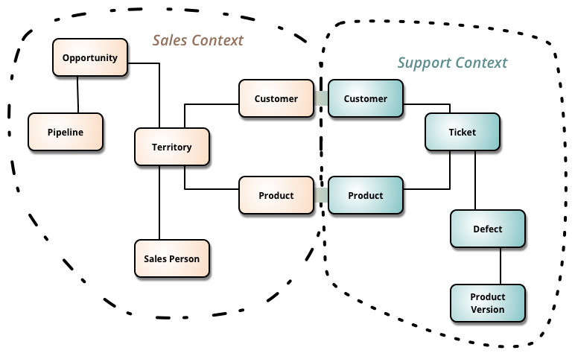
DDD - Strategic Design
Bounded Context
Ubiquitous Language
Context Map

Slide 16
Microservices in Practice
eCommerce

Slide 17
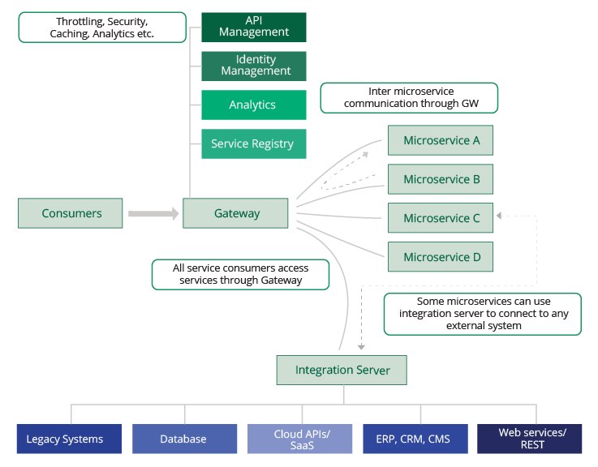
Microservices Architecture
Notes:
Stop: Sa se defineasca 4 microservicii pt eCommerce nostrul

Slide 18
eCommerce Microservices
Inventory microservice
Accounting microservice
Checkout microservice
Store microservice

Slide 19
eCommerce Microservices
REST API
Inventory microservice
REST API
Accounting microservice
REST API
Checkout microservice
REST API
Store microservice

Slide 20
REST
HTTP verbs
Get
Post
Put
Delete
Patch
Notes:
Https daca se vede url? De vazut

Slide 21
Business Capabilities
Inventory Context
Accounting Context
Pricing
Custommer
Stock
Address
Store Context
Checkout Context
Product
Cart
Category
Order
Notes:
Bounded Context

Slide 22
Communication
Notes:
Loosely coupled — By interacting through clearly defined interfaces, or through published events, each microservice remains independent of the internal implementation of its collaborators. For example, the orders service we introduced earlier shouldn’t be aware of the implementation of the account transactions service.

Slide 23
Interaction Styles
One-to-One | One-to-Many
Synchronous
Request / Response | --
Asynchronous
Notification | Publish / Subscribe
Request / Async response | Publish / Async response
Notes:
One-to-one – fiecare request este procesat de o singura instanta
One-to-many – fiecare request este procesat de mai multe instante
Synchronous – Clientul asteapta raspunsul o perioada de timp, perioada in care este blocat
Asynchronous – Clientul nu este blocat in timp ce asteapta un raspuns, iar dupa caz raspunsul poate sa nu fie trimis imediat
Request/response – un client face un request catre un serviciu si asteapta primirea raspunsul
Intr-o aplicatie bazata pe thread-uri, thread-ul care face request-ul este blocat cat timp asteapta raspunsul.
Notification (one-way request) – un client trimite un request catre un serviciu dar nu asteapta sa primeasca nici un raspuns
Request / Async response – un client trimite un request catre un seviciu, care raspunde asincron
Publish / Subscribe – un client publica un mesaj, ce este consumat de nici unul sau mai multe servicii / instante
Publish / Async responses – un client publica un mesaj, dupa care asteapta o perioada de timp raspunsul de la serviciile / instantele interesate

Slide 24
Point-to-point style
REST API
Accounting microservice
REST API
Inventory microservice
Consumer
REST API
Store microservice
REST API
Checkout microservice

Slide 25
Api-Gateway style
REST API
Accounting microservice
REST API
Inventory microservice
Consumer
API Gateway
REST API
Store microservice
REST API
Checkout microservice
Notes:
They create tighter coupling between services, as services must be aware of their collaborators.
They don’t have a strong model for broadcast or publish-subscribe models, limiting your capability to perform parallel work.
They block code execution while waiting on responses. In a thread- or process-based server model, this can exhaust capacity and trigger cascading failures.
Overuse of synchronous messages can build deep dependency chains, which increases the overall fragility of acall path.

Slide 26
Message-Broker style
Accounting microservice
subscriber
publisher
Inventory microservice
publisher
Consumer
subscriber
Store microservice
subscriber
Checkout microservice
publisher
Notes:
Events enable different styles of persistence and querying, such as event sourcing and command query responsibility segregation (CQRS). These aren’t a prerequisite for microservices but have some synergies with a microservice approach. We’ll explore them in chapter 5.
Decoupled

Slide 27
Coding time
Notes:
10:40 - 12:20
Microservices + Point to Point Communication

Slide 28
Coding time
Inventory Context
Accounting Context
REST API
Inventory microservice
Pricing
Custommer
Stock
Address
REST API
Accounting microservice
REST API
Checkout microservice
Store Context
Checkout Context
Product
Cart
REST API
Store microservice
Category
Order
Notes:
http://start.spring.io/
Web
H2
JPA
Rest Repositories
Lombok

Slide 29
Coding time
Inventory Context
Accounting Context
REST API
Accounting microservice
Pricing
Custommer
REST API
Inventory microservice
Stock
Address
Consumer
Store Context
Checkout Context
REST API
Store microservice
Product
Cart
Checkout microservice
Category
Order
REST API

Slide 30
Spring Cloud Gateway
Front door
Edge service
Routing and Filtering
Monitoring
Security
Notes:
Filter
pre filters are executed before the request is routed,
route filters can handle the actual routing of the request,
post filters are executed after the request has been routed, and
error filters execute if an error occurs in the course of handling the request.

Slide 31
Coding time
REST API
Accounting microservice
REST API
Inventory microservice
Consumer
API Gateway
REST API
Store microservice
REST API
Checkout microservice
Notes:
Should be done for the day!

Slide 32
Service Discovery
Server-side and Client-side

Slide 33
Why use
Service Discovery
Dynamically network location
Autoscaling
Failures
Upgrades

Slide 34
Server-Side Discovery
Inventory stack
Consumer Service
Request
Router
Request
Inventory microservice Instance 1
REST API
Registry Client
Discover service
Service location
REST API
Inventory microservice Instance 2
Service Registry
Register
Registry Client
REST API
Inventory microservice Instance 3
Registry Client
Notes:
AWS Elastic Load Balancer
HAProxy with Consul

Slide 35
Client-Side Discovery
Inventory stack
Consumer
Service
Request
Inventory microservice Instance 1
REST API
Registry Client
Discover service
Service location
REST API
Inventory microservice Instance 2
Service Registry
Register
Registry Client
REST API
Inventory microservice Instance 3
Registry Client
Notes:
Eureka

Slide 36
Coding time
REST API
Accounting microservice
REST API
Inventory microservice
Consumer
API Gateway
Register
REST API
Store microservice
Register & Discover
REST API
Checkout microservice
Service Registry
Eureka

Slide 37
Fault-Tolerance
Distributed Systems
Notes:
https://www.todaysoftmag.com/article/1531/fault-tolerant-microservices-with-netflix-hystrix
https://medium.com/netflix-techblog/fault-tolerance-in-a-high-volume-distributed-system-91ab4faae74a
https://martinfowler.com/bliki/CircuitBreaker.html
https://is.muni.cz/th/396542/fi_m/masters-thesis.pdf
https://www.youtube.com/watch?v=dKWNZnuZhd0
https://www.slideshare.net/chbatey/fault-tolerant-microservices-skills-matter

Slide 38
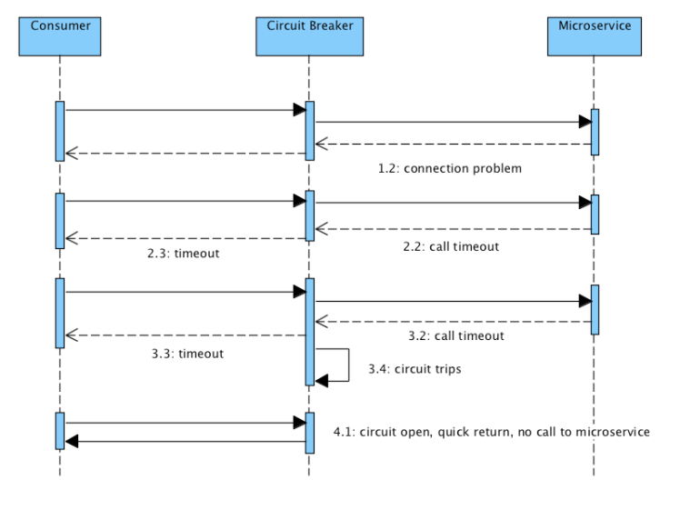
Circuit Breaker
Notes:
https://martinfowler.com/bliki/CircuitBreaker.html
https://nprogramming.wordpress.com/2016/02/27/the-circuit-breaker-design-pattern/
https://www.nginx.com/blog/microservices-reference-architecture-nginx-circuit-breaker-pattern/

Slide 39
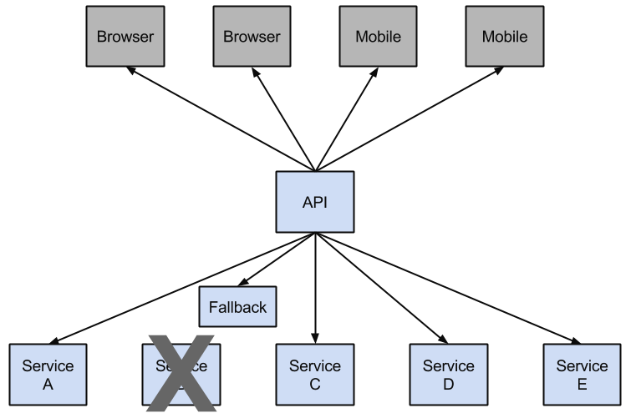
Hystrix Fallback
Notes:
https://www.baeldung.com/resilience4j

Slide 40
Feign
Declarative REST Client
Discovery Service - Eureka
Fallbacks - Hystrix
Request / Response compression
Notes:
feign.compression.request.enabled=true feign.compression.response.enabled=true
https://www.baeldung.com/resilience4j

Slide 41
Event-Driven
data management

Slide 42
Problem of Distributed Data
Checkout Context
Accounting Context
Order
Custommer
ORDER
CUSTOMER
id | customer_id | satus | total
id | credit | ...
Notes:
The Order Service cannot access the CUSTOMER table directly. It can only use the API provided by the Customer Service.
The Order Service could potentially use distributed transactions, also known as two-phase commit (2PC). However, 2PC is usually not a viable option in modern applications.
The CAP theorem requires you to choose between availability and ACID-style consistency, and availability is usually the better choice.
The second challenge is how to implement queries that retrieve data from multiple services.

Slide 43
CAP theorem
All clients see the same view of data, even right after update or delete
Consistency
CA
CP
X
AP
The system continues to work as expected, even in presence of partial network failure
All clients can find a replica of data, even in case of partial node failures
Availability
Partitioning
Notes:
The Order Service cannot access the CUSTOMER table directly. It can only use the API provided by the Customer Service.
The Order Service could potentially use distributed transactions, also known as two-phase commit (2PC). However, 2PC is usually not a viable option in modern applications.
The CAP theorem requires you to choose between availability and ACID-style consistency, and availability is usually the better choice.
The second challenge is how to implement queries that retrieve data from multiple services.

Slide 44
Event-Driven Architecture
Place Order
Checkout Context
Message Broker
Accounting Context
Order
Create event
Order
Create event
Order
Custommer
Credit Reserved
Credit Reserved
CUSTOMER
ORDER
id | credit | ...
202 | 5000
id | customer_id | satus | total
909 | 101 | OPEN | 1234
RESERVED_CREDIT
cust_id | order_id | amount
202 | 909 | 1234

Slide 45
Kafka
Message Broker
Topic - category or feed name in which messages are published
Broker - server process. The topics live in the broker processes
Producer - publishes data to topics
Consumer - processes subscribed to topic and process the feed of published messages
ZooKeeper - coordinator between the brokers and consumers
Notes:
RabbitMQ
ActiveMQ

Slide 46
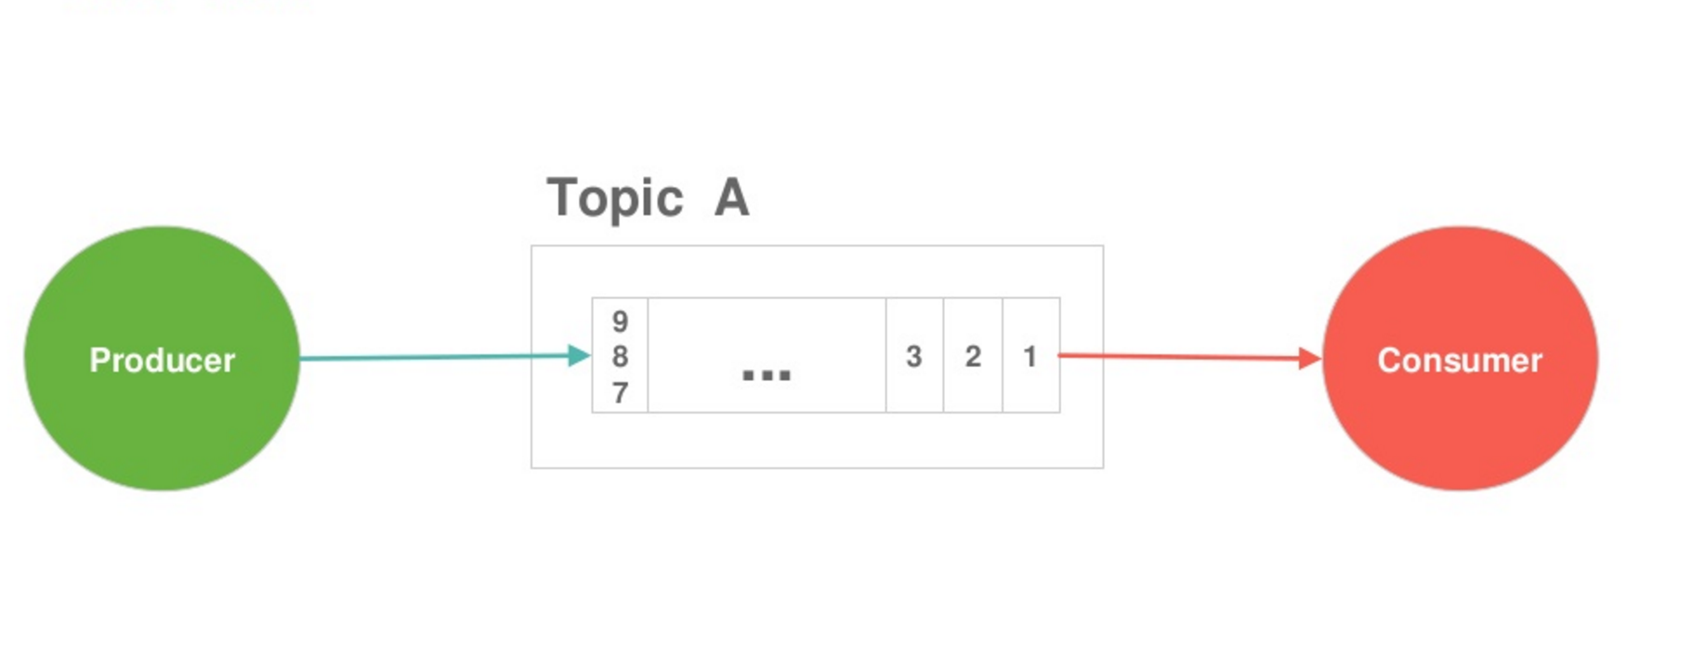
Connection the Microservices to Kafka
Notes:
https://www.slideshare.net/mongodb/powering-microservices-with-docker-kubernetes-kafka-mongodb-78227972?qid=c666fbf7-bdb7-4ff3-83ac-08d01aabad31&v=&b=&from_search=12
Producer scrie un singur event pe un topic / coada de mesaje (message queue). Consumer il citeste

Slide 47
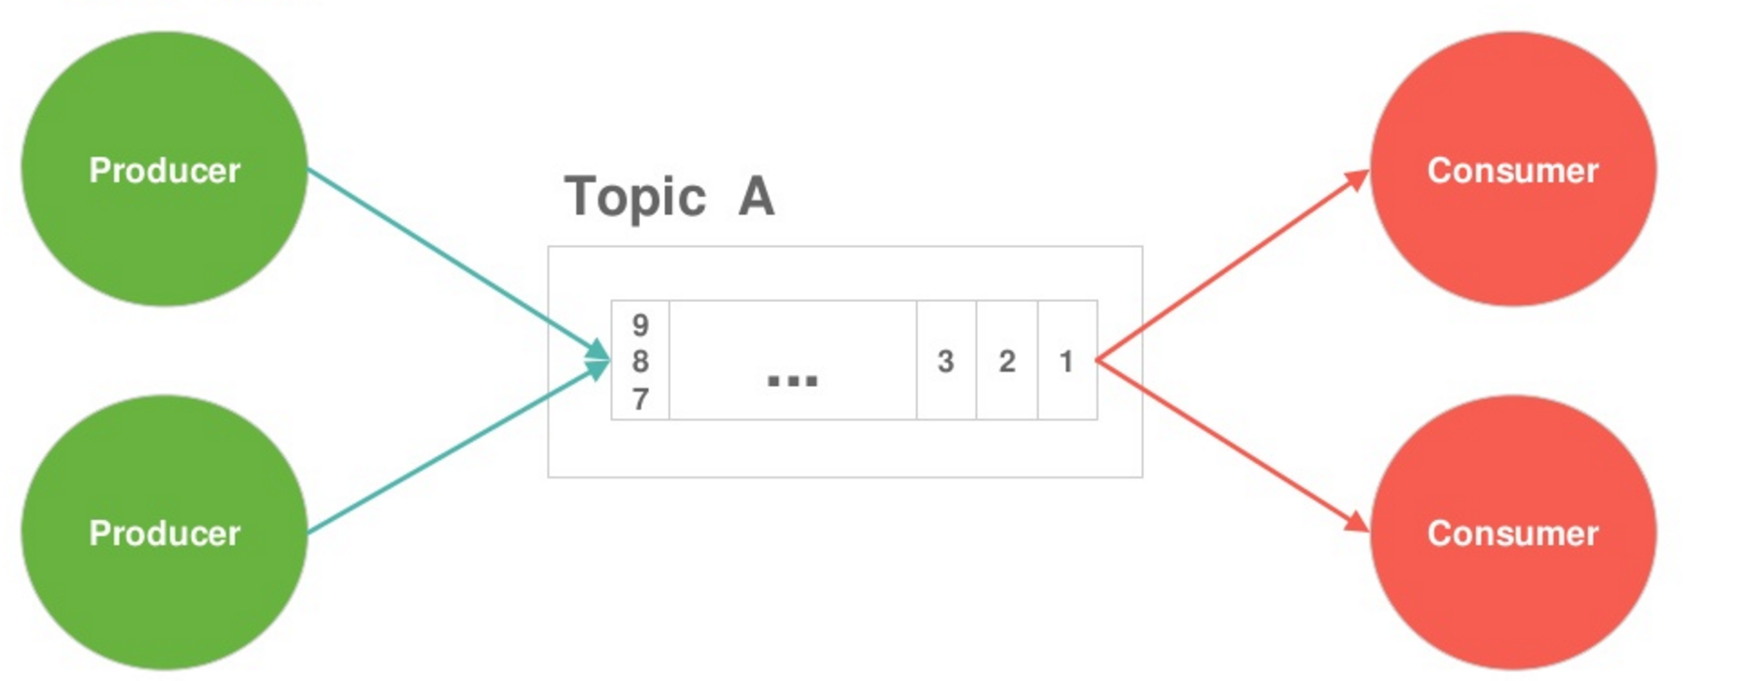
Connection the Microservices to Kafka
Notes:
Poti avea mai multi Producers care sa scrie in acelasi Topic.
Consumers pot sa primeasca mesajele de la momentul in care s-a conectat la Kafka sau putem sa-l setam sa citeasca mesajele de la inceput.
Ex: nou algorit de calcul ce se vrea aplicta proactiv

Slide 48
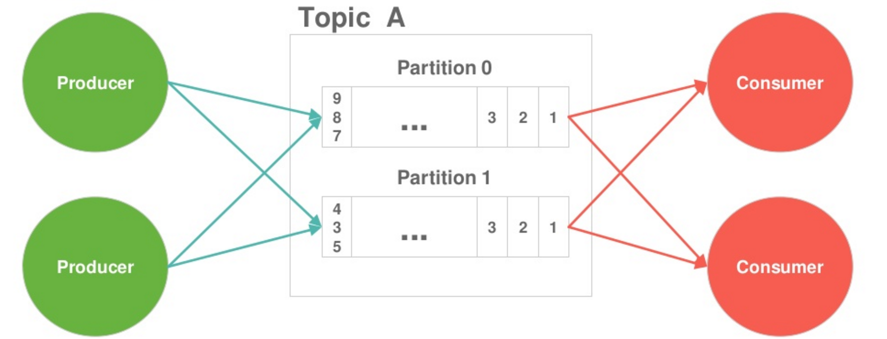
Connection the Microservices to Kafka
Notes:
Scalling
Imparti mesajele in mai multe partitii in functie de un field din mesaj

Slide 49
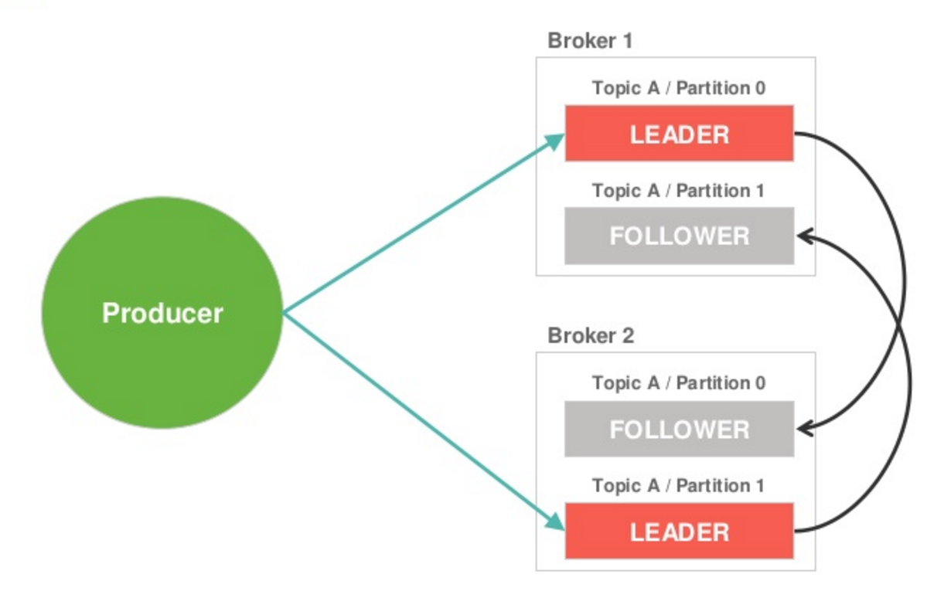
Connection the Microservices to Kafka
Notes:
High Availability

Slide 50
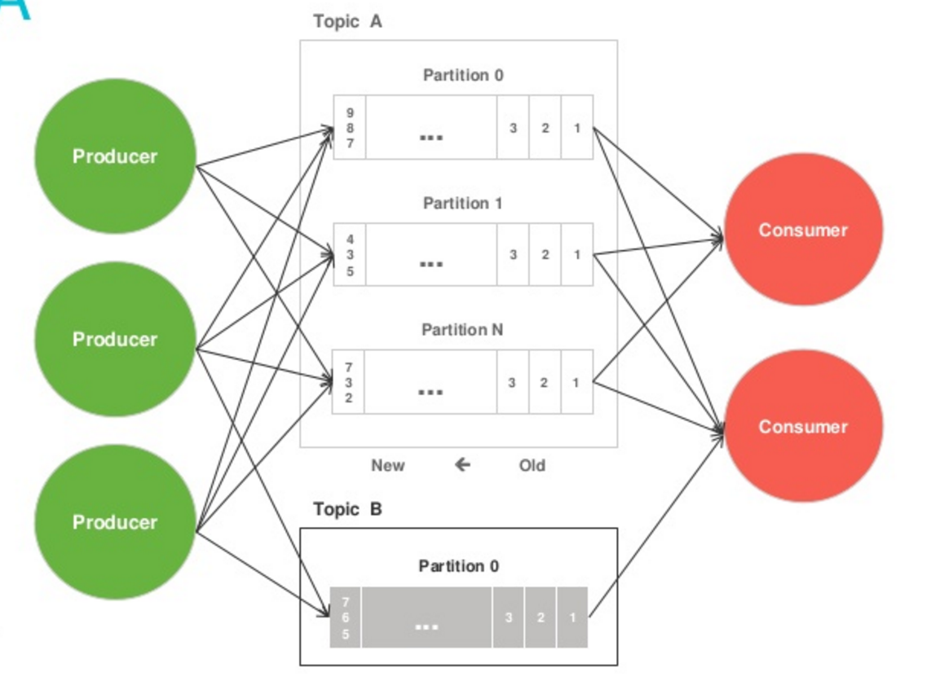
Connection the Microservices to Kafka

Slide 51
Kafka Cluster
Producer
Producer
Producer
Producer
Kafka Cluster
ZooKeeper Ensemble
Node 1
Node 2
Zookeeper 1
Kafka Broker 3
Kafka Broker 1
Kafka Broker 2
Zookeeper 2
Zookeeper 3
Consumer
Consumer
Consumer
Consumer

Slide 52
Coding time
Accounting microservice
publisher
Consumer
API Gateway
REST API
Inventory microservice
subscriber
Store microservice
subscriber
Checkout microservice

Slide 53
Saga
Transaction model
Notes:
https://www.youtube.com/watch?v=YPbGW3Fnmbc
https://microservices.io/patterns/data/saga.html

Slide 54
Transaction and Compensation
Fails
T1
T2
...
C1
C2
...
Compensating transactions
T1 -> T2 -> C1

Slide 55
Choreography Coordination
Insufficient credit
Order Service
Local transaction
rejectOrder()
FAIL
Order Service
Customer Service
Local transaction
createOrder()
Local transaction
reserveCredit()
Order Service
Local transaction
approveOrder()

Slide 56
Orchestration Coordination
CreateOrderSaga
Order Service
Customer Service
Order Service
Local transaction
createOrder()
Local transaction
reserveCredit()
Local transaction
approveOrder()

Slide 57
Coding time
Place Order
Message Broker
Accounting Context
Checkout Context
3 Order Created
Cart
5 Stock Reserved
Custommer
4 Credit Reserved
1 Cart to Order
2 Order Created
Order
5 Credit Reserved
Inventory Context
Store Context
3 Order Created
Stock
5 Stock Reserved
Product
4 Stock Reserved
Notes:
Should be done for the day!

Slide 58
Security
Patterns and Best Practices
Notes:
https://dzone.com/articles/advanced-microservices-security-with-spring-and-oa
https://www.youtube.com/watch?v=ZXGaC3GR3zU

Slide 59
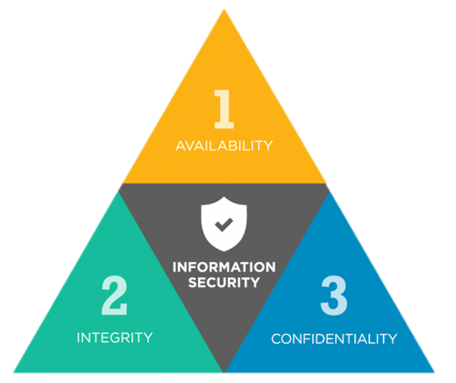
Security Model
Availability is guarantee of reliable access to the information by authorized people.
Integrity is the assurance that the information is trustworthy and accurate.
Confidentiality is set of rules that limits access to information.

Slide 60
API Gateway / Perimeter security
Requests are authenticated and authorized by the gateway
The public LB cannot send request to apps directly
Apps trust all traffic they receive by assumption
Pros
Network setup can virtually guarantee assumptions
Apps have stateless security
Cons
Does noting for internal threats

Slide 61
Basic + Central Auth DB
All apps get to do authentication and authorization themselves
Credentials are verified against a central DB
Basic credentials are passed along in every request
Pros
Stateless - authenticate every time
Central user store
Cons
Auth DB is hit every request
DB lookup logic needs to be implemented everywhere
User’s credentials can unlock all functionality

Slide 62
Sessions everywhere
Same as before but each app gets to maintain a session with the client device
Pros
Auth DB is hit once per session
Cons
Hard to manage all the sessions
No single sign on
DB lookup logic needs to be implemented everywhere
User’s credentials can unlock all functionality

Slide 63
API Tokens
Username and password is exchanged for a token at a centralized auth server
Apps validate the token for each request by hitting the auth server
Pros
App don’t see user credentials
Cons
Auth server bottleneck
Token provides all or nothing access

Slide 64
Microservices
Security Concerns
Central user store bottleneck
Single Sign On
Statelessness
User credentials
Fine grained authorization
Interoperability with non browser
Notes:
https://www.nginx.com/solutions/application-security/
https://www.nginx.com/page/7/?s=security
https://www.slideshare.net/cmoulliard/security-enforcement-of-java-microservices-with-apiman-keycloak?qid=a0eafcf7-a057-4722-badd-92e2f96dfe55&v=&b=&from_search=7
https://www.slideshare.net/cloudflare/cloud-flare-amp-sans-webinar-securing-microservices?qid=a0eafcf7-a057-4722-badd-92e2f96dfe55&v=&b=&from_search=4

Slide 65
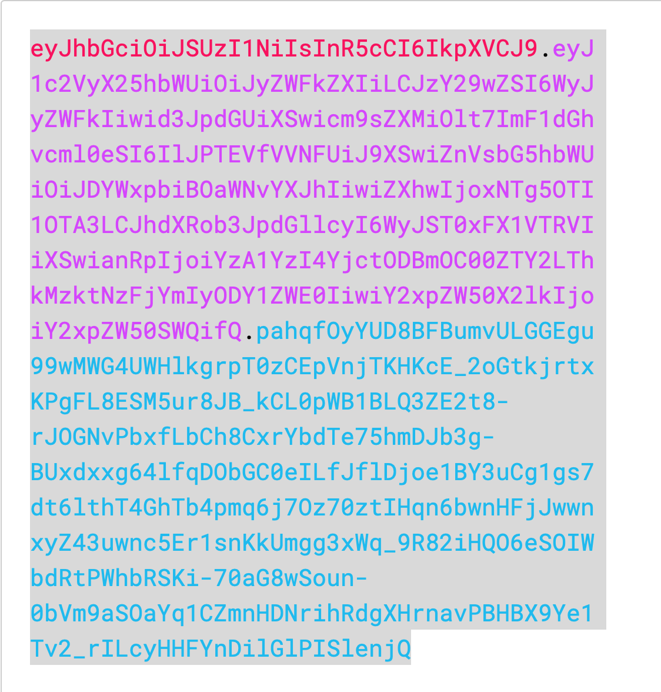
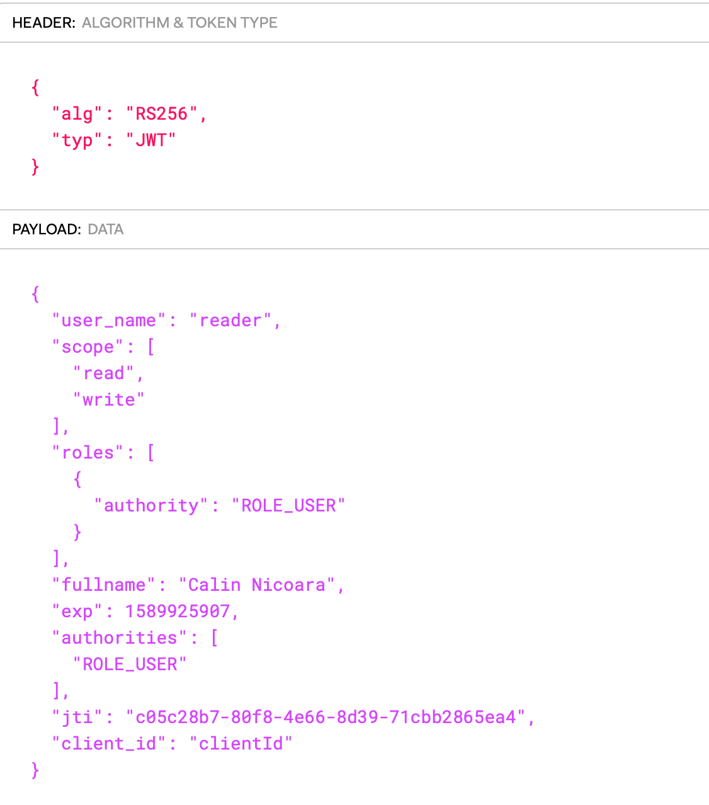
JWT Token

Slide 66
Oauth2 Concepts
Resource Owner - The user who authorizes an application to access his account. The access is limited to the scope.
Resource Server - A server that handles authenticated requests after the client has obtained an access token
Client - An application that access protected resources on behalf of the resource owner.
Authorization Server - A server which issues access tokens after successfully authenticating a client and resource owner and authorizing the request.
Access Token - A unique token used to access protected resources
Scope - A Permission (Example: READ, WRITE)
JWT - JSON Web Token is a method for representing claims securely between two parties
Grant type - a method of acquiring an access token.

Slide 67
OAuth2 and OpenID Connect
User Store
Authorization Server
Accounting microservice
REST API
Access Token
JWT
REST API
Inventory microservice
Access Token
JWT
Consumer
API Gateway
REST API
Store microservice
REST API
Checkout microservice
JWT processing at each microservice
Notes:
JWT - JSON Web Token
Generate JWT token keystore
$ keytool -genkeypair -alias jwt -keyalg RSA -dname "CN=microservice, L=Bucuresti, C=RO" -keypass mySecretKey -keystore jwt.jks -storepass mySecretKey
$ keytool -list -rfc --keystore jwt.jks | openssl x509 -inform pem -pubkey
Copy public key into public.cert and copy it to src/main/resources
start.spring.io
Web
Cloud OAuth2
get access tokens curl -X POST "web_app:@localhost:9999/oauth/token" -d "grant_type=password&username=reader&password=12345678"
curl -H "Authorization: Bearer $TOKEN" .....
http://stytex.de/blog/2016/02/01/spring-cloud-security-with-oauth2/

Slide 68
Testing
Strategies
Notes:
https://www.xenonstack.com/blog/testing-strategies-in-microservices-architecture
https://martinfowler.com/articles/microservice-testing/
https://www.slideshare.net/renan_/testing-microservices-architectures
AR TREBUIE SA FIE GATA INAINTE DE ACEST SLIDE

Slide 69
Testing Pyramid
End-to-End Tests
Contract Tests
Time Required to Execute
Verisimilitude
Number of Tests
Frequency of Execution
Component Tests
Integration Tests
Unit Tests

Slide 70
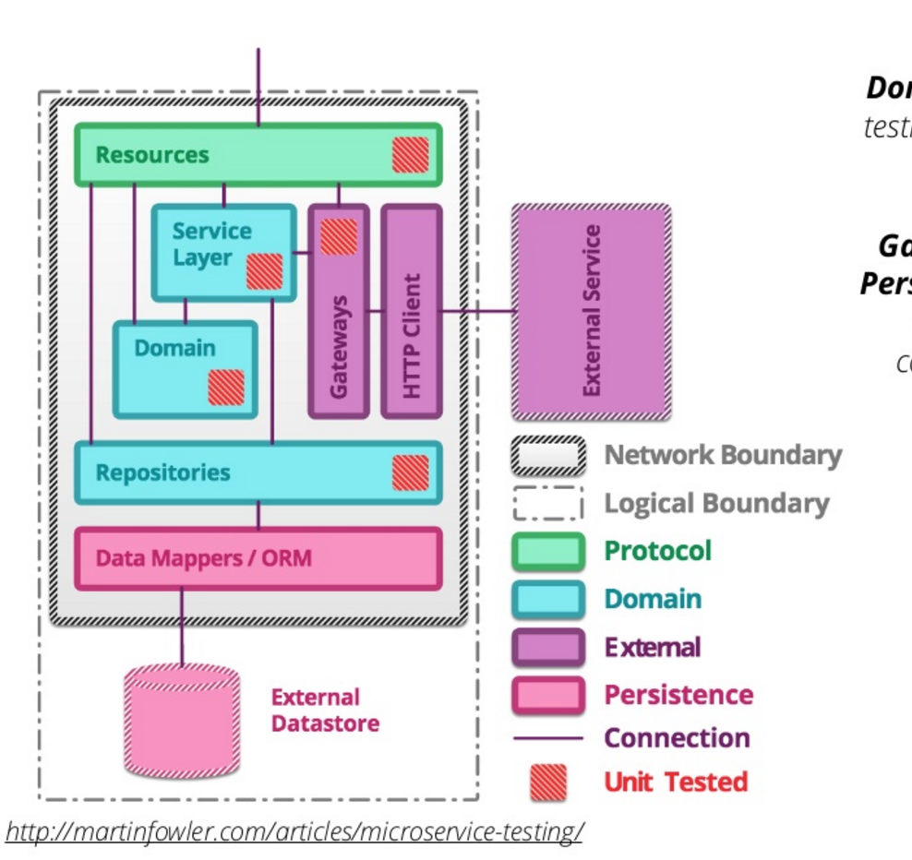
Unit Testing
Make sure that the each component behave as expect.
Domain
Gateways
Resources
Persistence
Notes:
Sociable Unit Testing - It focuses on testing the behaviour of modules by observing changes in their state.
Solitary Unit Testing - It looks at the interactions and collaborations between an object and its dependencies

Slide 71
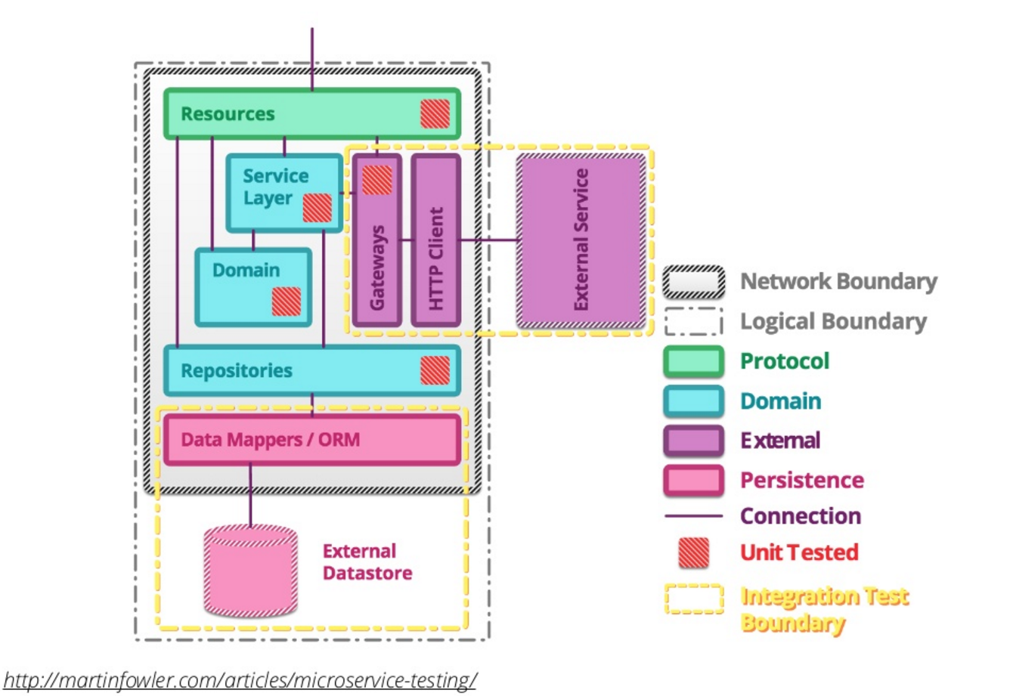
Integration Testing
Verifying the communications and interactions between components
Persistence
Gateways
Notes:
These tests are designed to test basic success and error paths over a network boundary.
Persistence integration tests provide assurances that the schema assumed by the code matches that is available in the data store.

Slide 72
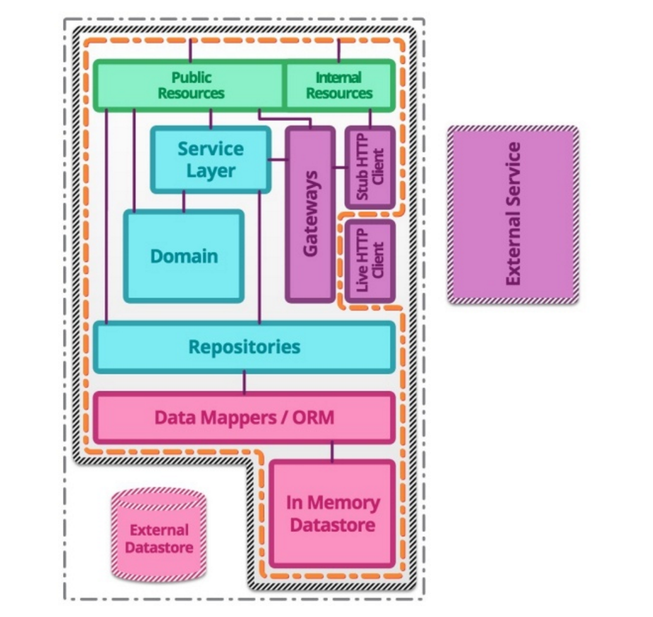
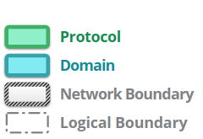
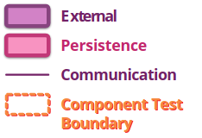
Component Testing
Testing the service in isolation
In Memory DB
Stub HTTP Client
Simulate external service
Notes:
Tests the full function of a single microservice. During this type of testing, any calls to external services are mocked in some way.

Slide 73
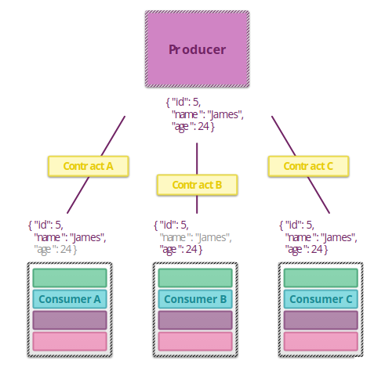
Contract Testing
Verifying the agreements between producer and consumers services
Input & Output data structure
Calls attributes
Notes:
https://cloud.spring.io/spring-cloud-contract/

Slide 74
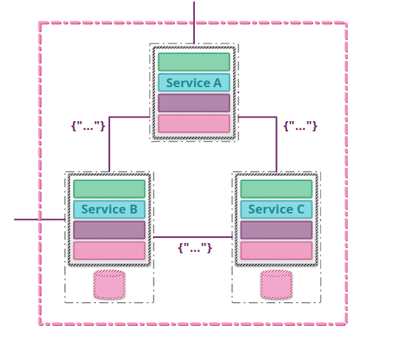
End-to-End Testing
Testing the behaviour of the entire system
Business flow
Proxies
Load Balancers

Slide 75
Deployment
Strategy
Notes:
https://www.slideshare.net/iamabhishektiwari/microservices-deployment-patterns-63249852?qid=fd0396a0-f32a-4c93-8798-dd558fb8cf26&v=&b=&from_search=6

Slide 76
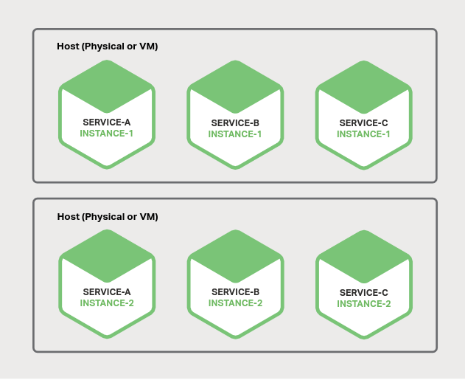
Multiple Service Instances per Host
Pros
Efficient resource utilization
Fast deployment
Cons
Poor isolation
Difficult to limit resource utilization
Risk to dependency version conflicts
Poor encapsulation of implementation technology

Slide 77
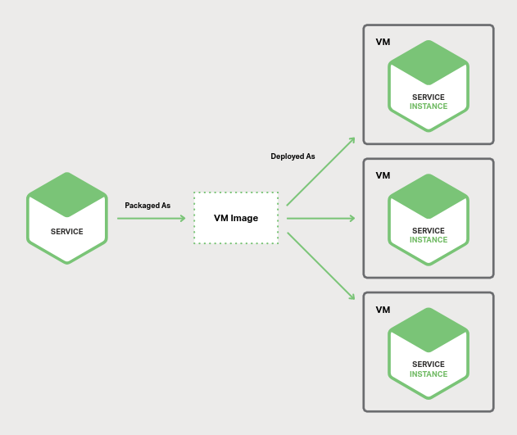
Service Instance per Virtual Machine
Pros
Great isolation
Great manageability
VM encapsulates implementation technology
Cons
Less efficient resource utilization
Slow deployment

Slide 78
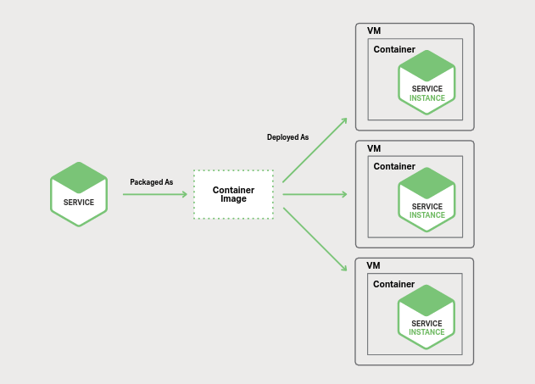

Service Instance per Container
Pros
Great isolation
Great manageability
Container encapsulates implementation technology
Efficient resource utilization
Fast deployment
Cons
Immature infrastructure for deploying containers

Slide 79
Deployment
With containers
Notes:
https://www.slideshare.net/iamabhishektiwari/microservices-deployment-patterns-63249852?qid=fd0396a0-f32a-4c93-8798-dd558fb8cf26&v=&b=&from_search=6

Slide 80

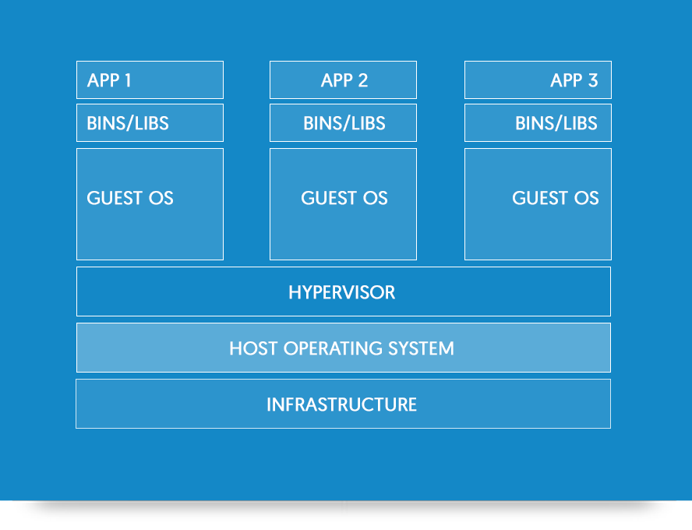
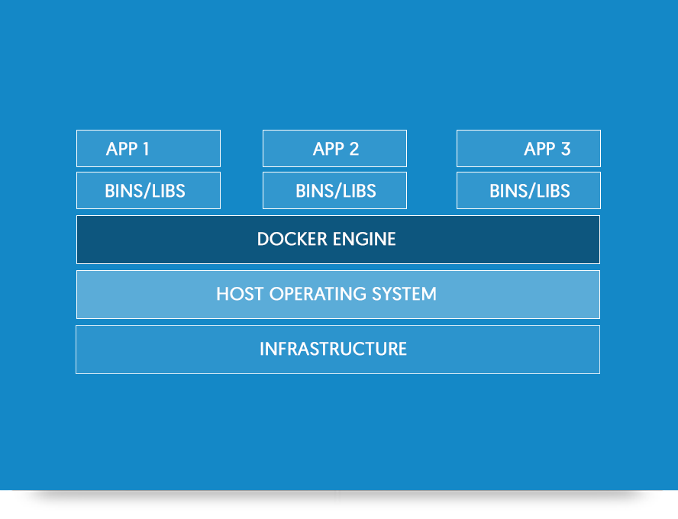
Docker
Source: https://www.docker.com/what-docker
Notes:
https://martinfowler.com/bliki/CanaryRelease.html

Slide 81

Microservices requirements
API
Tracing
Discovery
Monitoring
Invocation
Logging
Elasticity
Authentication
Resilience
Pipeline

Slide 82

Kubernetes
Kubernetes coordinates a highly available cluster of computers that are connected to work as a single unit.

Slide 83
What Kubernetes covers
API
Tracing
Discovery
Monitoring
Invocation
Logging
Elasticity
Authentication
Resilience
Pipeline

Slide 84
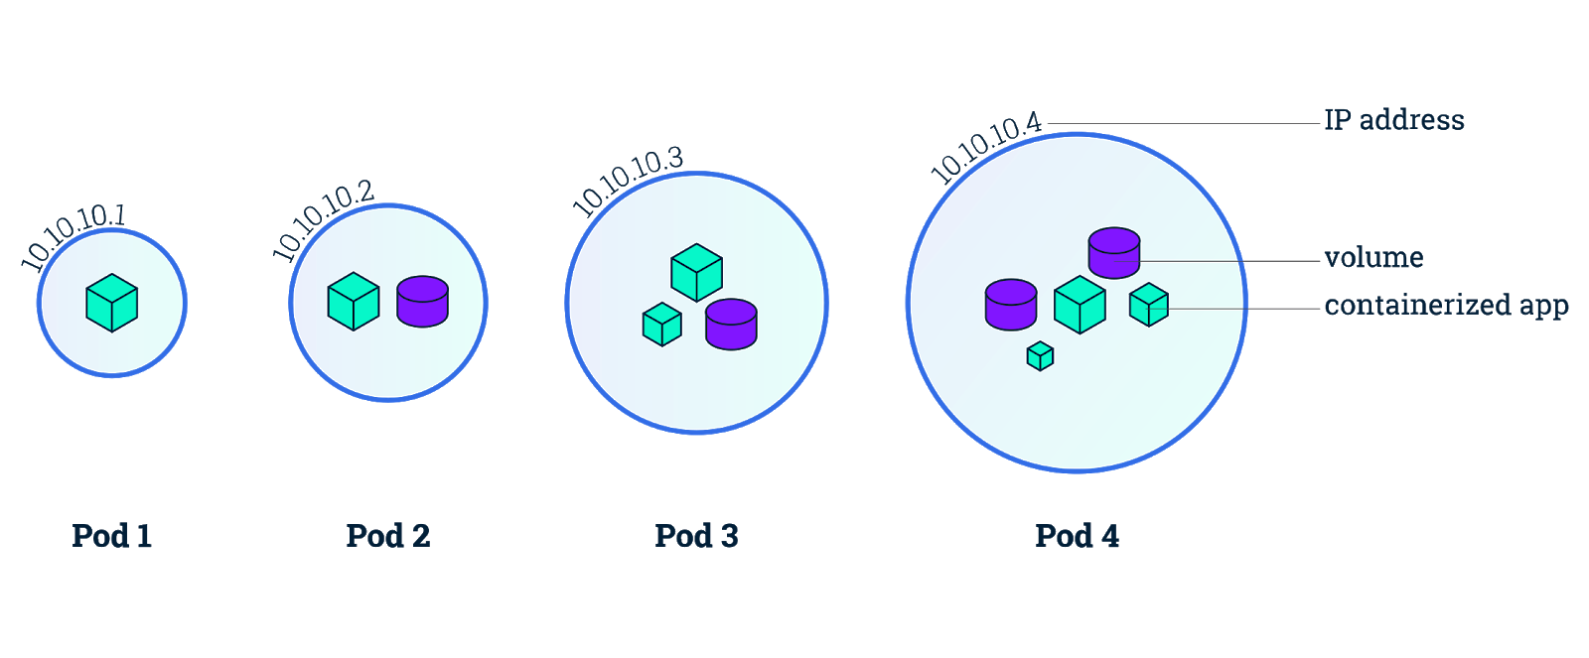
Kubernetes Pods

Slide 85
Deployment
Patterns
Notes:
https://www.slideshare.net/iamabhishektiwari/microservices-deployment-patterns-63249852?qid=fd0396a0-f32a-4c93-8798-dd558fb8cf26&v=&b=&from_search=6

Slide 86
Rolling Update
Router
Instance 1 V1
Instance 2 V1
Instance 3 V1
Old Group
New Group
Notes:
https://martinfowler.com/bliki/CanaryRelease.html

Slide 87
Rolling Update
Router
Instance 1 V1
Instance 2 V1
Instance 3 V1
Instance 1 V2
Old Group
New Group
Notes:
https://martinfowler.com/bliki/CanaryRelease.html

Slide 88
Rolling Update
Router
Instance 1 V1
Instance 2 V1
Instance 3 V1
Instance 1 V2
Old Group
New Group
Notes:
https://martinfowler.com/bliki/CanaryRelease.html

Slide 89
Rolling Update
Router
Instance 2 V1
Instance 3 V1
Instance 1 V2
Instance 2 V2
Old Group
New Group
Notes:
https://martinfowler.com/bliki/CanaryRelease.html

Slide 90
Rolling Update
Router
Instance 3 V1
Instance 1 V2
Instance 2 V2
Instance 3 V2
Old Group
New Group
Notes:
https://martinfowler.com/bliki/CanaryRelease.html

Slide 91
Rolling Update
Router
Instance 1 V2
Instance 2 V2
Instance 3 V2
Old Group
New Group
Notes:
https://martinfowler.com/bliki/CanaryRelease.html

Slide 92
Canary Release
Router
All users - 100%
0%
Instance 1 V1
Instance 2 V1
Instance 3 V1
Instance 1 V2
Instance 2 V2
Instance 3 V2
Old Version
New Version
Notes:
https://martinfowler.com/bliki/CanaryRelease.html

Slide 93
Canary Release
Router
Most users - 95%
Some users - 5%
Instance 1 V1
Instance 2 V1
Instance 3 V1
Instance 1 V2
Instance 2 V2
Instance 3 V2
Old Version
New Version
Notes:
https://martinfowler.com/bliki/CanaryRelease.html

Slide 94
Canary Release
Router
0%
All users - 100%
Instance 1 V1
Instance 2 V1
Instance 3 V1
Instance 1 V2
Instance 2 V2
Instance 3 V2
Old Version
New Version
Notes:
https://martinfowler.com/bliki/CanaryRelease.html

Slide 95
Blue-Green
DNS
service-1.domain.com
Router
Instance 1 V1
Instance 2 V1
Instance 3 V1
Old Group
Notes:
https://martinfowler.com/bliki/CanaryRelease.html

Slide 96
Blue-Green
DNS
service-1.domain.com
Router
Router
Instance 1 V1
Instance 2 V1
Instance 3 V1
Instance 1 V2
Instance 2 V2
Instance 3 V2
Old Group
New Group
Notes:
https://martinfowler.com/bliki/CanaryRelease.html

Slide 97
Blue-Green
DNS
service-1.domain.com
Router
Router
Instance 1 V1
Instance 2 V1
Instance 3 V1
Instance 1 V2
Instance 2 V2
Instance 3 V2
Old Group
New Group
Notes:
https://martinfowler.com/bliki/CanaryRelease.html

Slide 98
Monitoring
Microservices
Notes:
https://www.slideshare.net/iamabhishektiwari/microservices-deployment-patterns-63249852?qid=fd0396a0-f32a-4c93-8798-dd558fb8cf26&v=&b=&from_search=6
https://www.youtube.com/watch?v=emaPPg_zxb4

Slide 99
What to monitor?
Hosts CPU, Memory, I/O, Network, File system
Containers CPU, Memory, I/O, Restarts, Bottleneck
Applications Latency, Traffic, Errors
Notes:
Throttling = bottleneck

Slide 100
Metrics & Alerts
VM
cAdvisor
Query
Grafana Visualize metrics
Collect Containers metrics
Docker Engine
Email
Service Instance
JMX
Container
Scrape metrics
Prometheus Metrics database
Push
AlertManager Send notifications
Slack
Service Instance
JMX
Pushover
Container
Collect OS metrics
Node Exporter

Slide 101
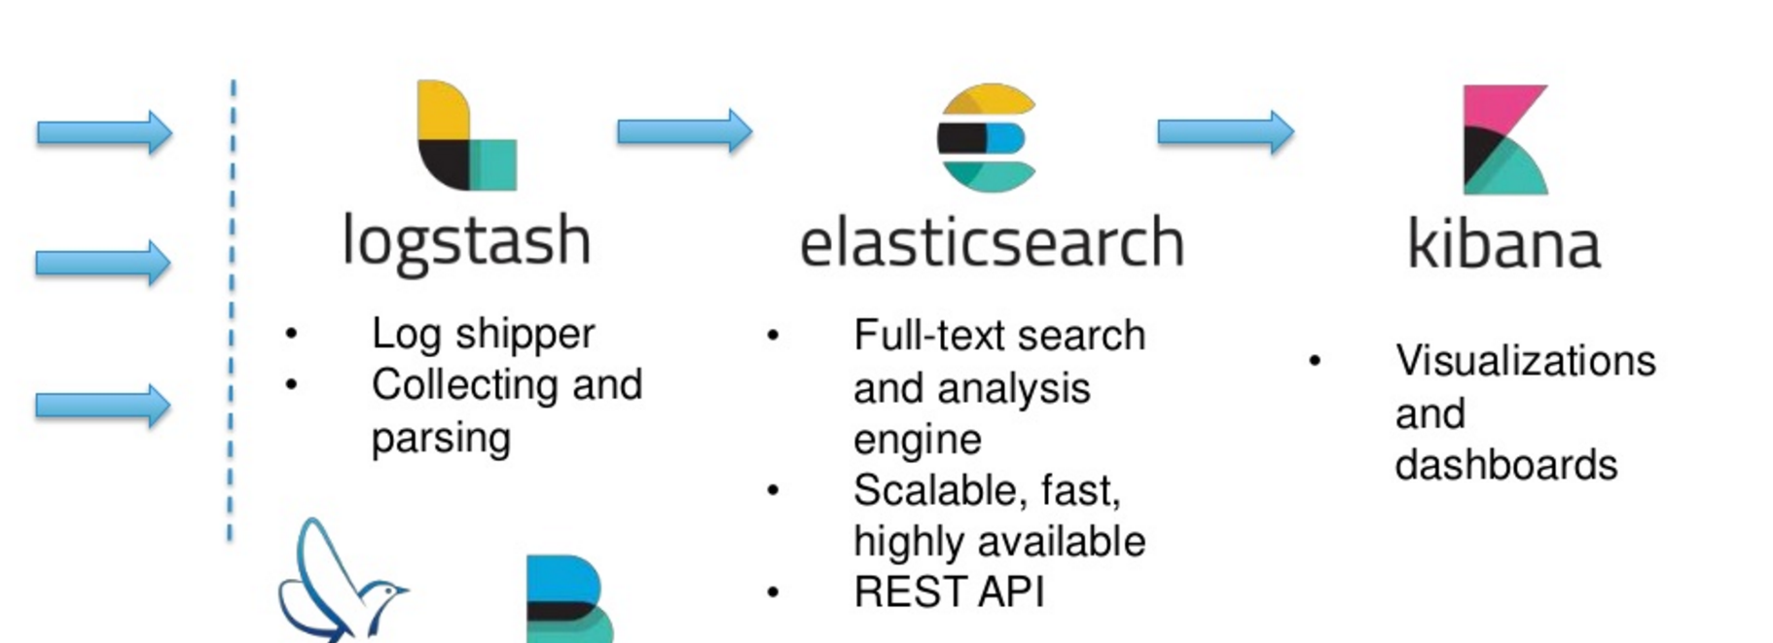
Logging & Tracing

Slide 102

Forward the foundation!
Organization that brings together the world’s top developers, end users and vendors.
Hosts critical components of the global technology infrastructure
Part of the non-profix Linux Foundation
Notes:
https://martinfowler.com/bliki/CanaryRelease.html

Slide 103
Splitting a Monolith
In Microservices

Slide 104
Start with an easy one
Monolith
Monolith
Microservice
Checkout
Payment
Checkout
Payment
Email
Delivery
Stock
Delivery
Stock
Email

Slide 105
New service should not depend on the monolith
Not okay!
Okay!
Monolith
Microservice
Monolith
Microservice
Checkout
Payment
Email
Checkout
Payment
Delivery
Stock
Email
Delivery
Stock

Slide 106
Extract what changes often
Monolith
Monolith
Microservice
Checkout
Payment
Checkout
Payment
Delivery
Stock
Delivery
Stock

Slide 107
Most of times it is better to rewrite and retire the old code
Monolith
Monolith
Microservice
Checkout
Legacy Payment
Checkout
Legacy Payment
New Payment
Delivery
Stock
Delivery
Stock

Slide 108
Better to go from big to small
Monolith
Monolith
Microservice
Checkout
Payment
Checkout
Payment
Product Catalog
Stock
Delivery
Stock
Delivery
Product Catalog

Slide 109
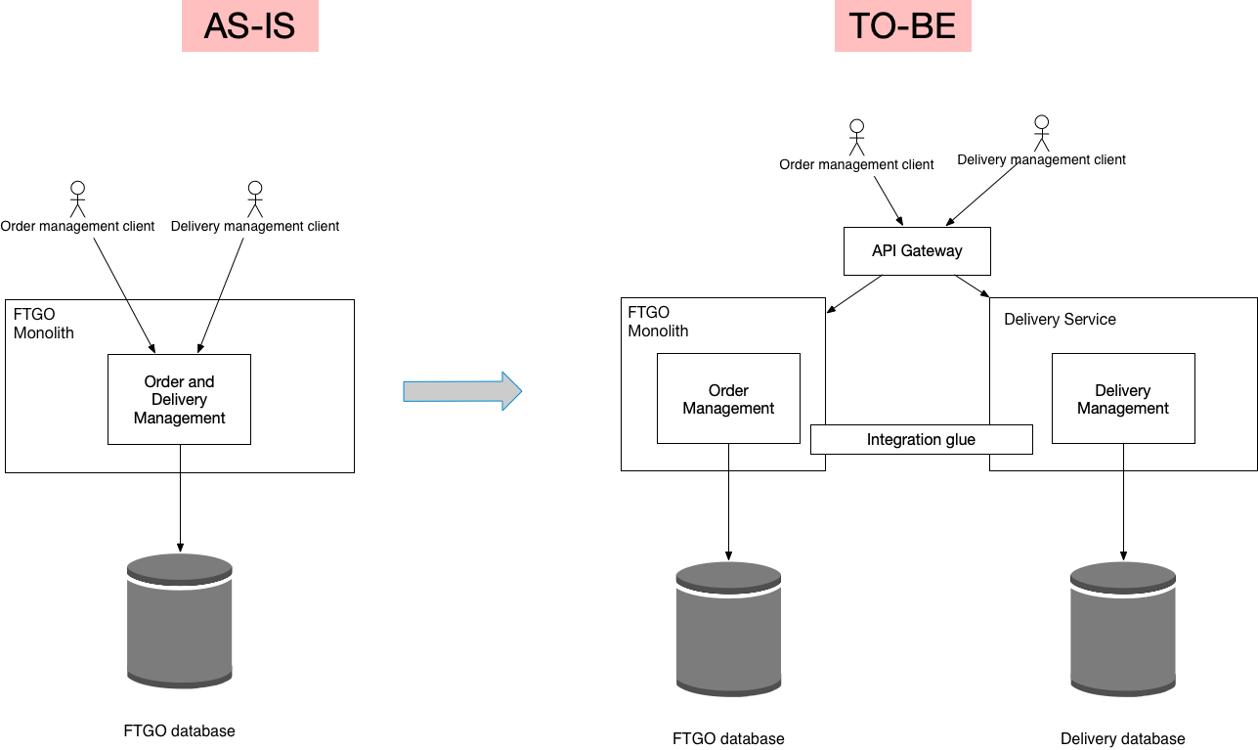
Source: https://microservices.io/refactoring/

Slide 110
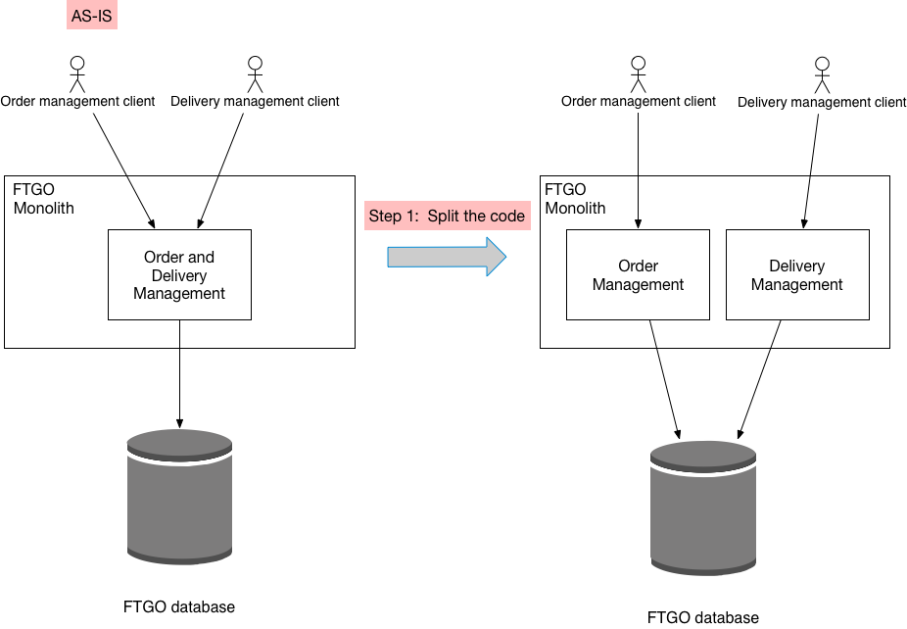
Source: https://microservices.io/refactoring/

Slide 111
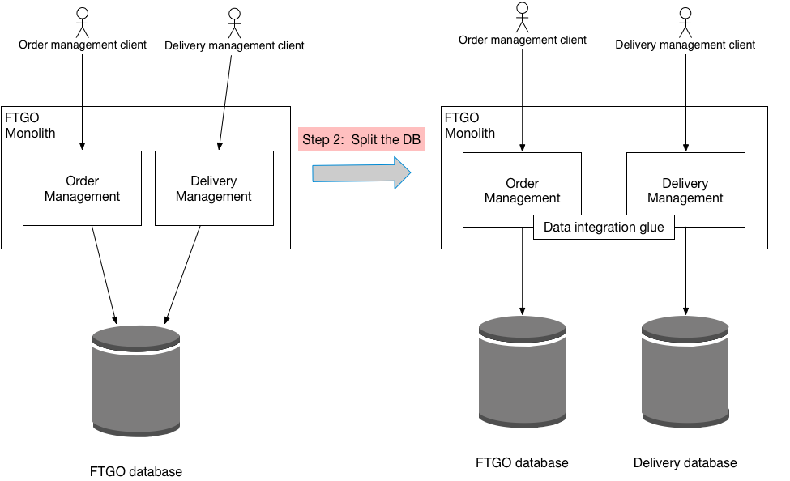
Source: https://microservices.io/refactoring/

Slide 112
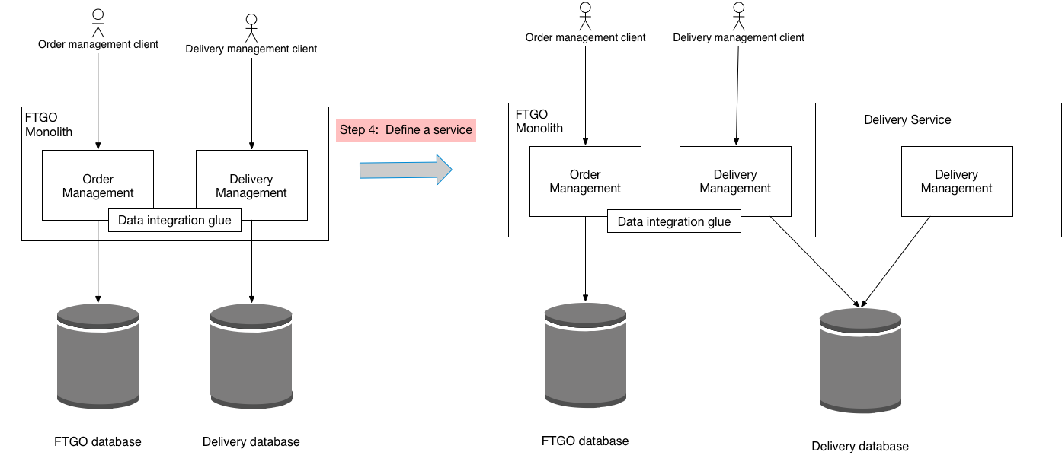
Source: https://microservices.io/refactoring/

Slide 113
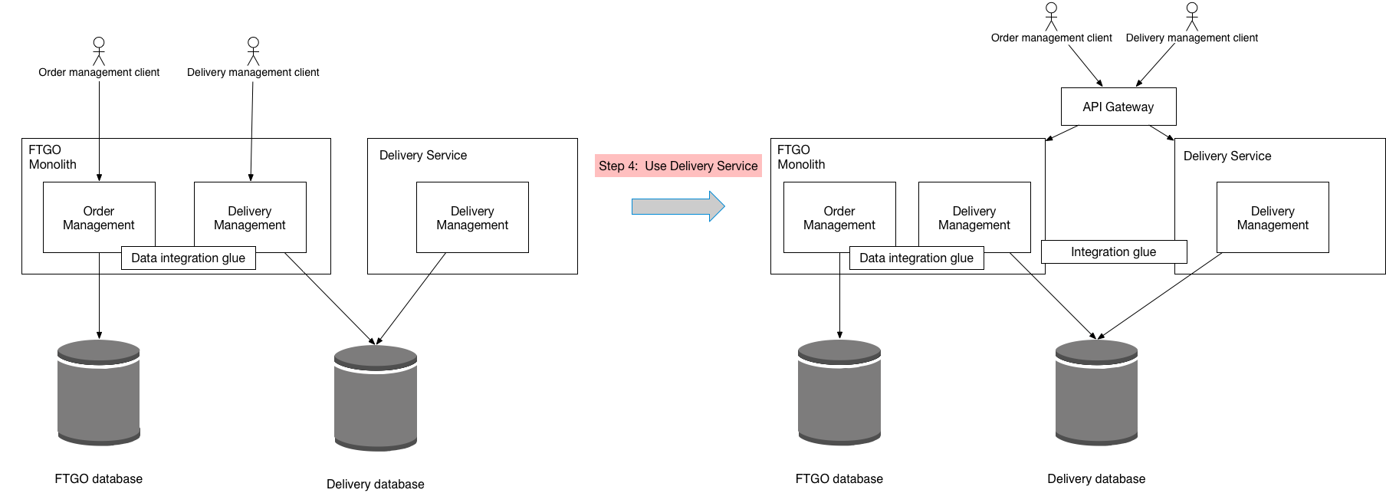
Source: https://microservices.io/refactoring/

Slide 114
